Slide 1


A Hybrid System for Research Paper Recommendation
and
Text Summarization
Presented by:
Chitransh Bose-MT22096
Ranit Pal-MT22119
Soumyajyoti Das-MT22075
Varun Jhunjhunwala-MT22087
Group - 26

Slide 2
Contents
Problem Statement
Literature Review
Proposed Solution
Approaches
Methodology
Flowchart
Novelty
Future Works
Contribution
Conclusion

Slide 3
Baseline Vs System Performance
In the baseline, we worked with datasets which contain nearly 1784 rows. In the Baseline though we recommended the paper but it was not efficient, but now we are working with a dataset which contains approximately 24 lakhs of data and here we are not only recommending, we are also summarizing , and from the summarized papers we are again recommending which is unique in our project. We are also showing the title and the summary simultaneously which were not in the baseline results.

Slide 4
State Of The Art
Whatever state of the arts systems are there don’t recommend and summarizes correspondingly .But our system is summarizing section wise and again on the summarized data we are reranking our recommendation which are unique and more efficient than normal recommending the papers.

Slide 5
Problem Statement
The problem with the existing system like Google Scholar, is that it only provides paper recommendations which requires users to go through the entire paper to determine if it is relevant or not for their research. This can be time-consuming and frustrating for users who are trying to efficiently find relevant research material.

Slide 6
Literature Review
01 | Joeran Beal et al., in their paper, have provided a survey based on a research paper recommendation system, in which they have identified the methods which are mostly used for recommendations along with the various shortcomings that are present in various papers like the choice of evaluation metrics, etc.
02 | Joonseok Lee et al., have proposed a Personalized Academic Research Paper recommendation system that recommends the use of articles and papers related to the interest of the user by finding the similarity between the text using collaborative filtering. As there is a lot of information present over the internet these days, the extraction of relevant documents and further the relevant information is very important.
03 | S.A. Babar et al., in their paper, have presented a system for text summarization. They have discussed various text summarization methods like TF-IDF, Graph-theoretic approach, Machine Learning approach, and Automatic Text Summarization based on Fuzzy logic.
04 | Julian Kupiec et al. propose a trainable document summarizer that uses a neural network architecture to generate summaries of input documents. They evaluated their approach on a benchmark dataset and compared it to existing summarization systems.
05 | S.M. Kamruzzaman et al. in their work have proposed a new algorithm for the classification of text that is based on the word relation rather than the word only using a lesser number of documents for training. Further, it uses Naïve Bayes for extracting the features.

Slide 7

Proposed Solution
Introducing an innovative and efficient approach to tackle the overwhelming issue of information overload - a paper recommendation system and text summarization method that leverages filtering methods and summarization techniques.
This cutting-edge solution is designed to streamline the process of identifying relevant research papers and generating concise summaries, making it a valuable tool for researchers, academics, and knowledge-seekers alike.

Slide 8

Approaches
Recommendation
Text Summarization
Content Based
Collaborative
Extractive
Abstractive

Slide 9
Methodology
Step 1
Step 2
Step 3
Step 4
Step 5
Step 6
Step 7
Step 8
Preprocessing on the existing datasets
Model Creation
Recommendation
Fetching
Summarizing the chosen papers
Model Creation
Rerank the papars
Evaluation

Slide 10
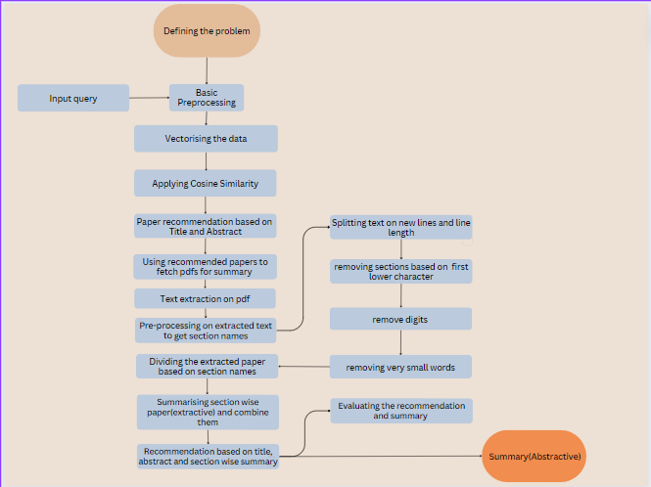
Flow Chart

Slide 11
01
Recommendation
We will provide a summary of the recommended papers and then perform vectorization on the recommended papers to further refine the recommendations and re-rank the papers ,to increase the efficiency of reccomendation.
Novelty
02
Quick Overview
A culmination of paper recommendation and text summarization will be a great boon to the researchers by saving them from wasting time on fully exploring non relevant information.

Slide 12


Future Works
Multi Modal Summarization
Domain Specific Summarization
Better Pdf Extraction

Slide 13
Contribution
Ranit Pal:
Research paper recommendation
Soumyajyoti Das:
Research paper recommendation
Chitransh Bose:
Text Summarization
Varun Jhunjhunwala:
Text Summarization

Slide 14
Conclusion
Although there were systems like Google scholar that recommends the research paper but as the size of information is increasing rapidly the need for the system that summarizes the content in order to save the time is important. Thus, we have proposed a system that recommends the paper and generates the summary. The summary is generated section wise and then the re-ranking of the paper is done to provide better results to the user and finally the abstractive summary is provided. Generating a summary is a difficult task as the format of the papers is not uniform also it requires heavy computational power. Thus, we faced these limitations and the system can be improved in future by overcoming these faced challenges.

Slide 15
Thank You

